Slide 1


mcxtrace-1.x vs. mcxtrace-3.0, status and elements of the GPU port
Peter Willendrup and Erik Knudsen DTU Physics

Slide 2
Agenda
McXtrace on GPU via OpenACC (a “high-level” #pragma driven access to CUDA see https://www.openacc.org and https://developer.nvidia.com/hpc-sdk)
How well (fast) does it work?
Simulation flow
What did we change?
What needs doing on an instrument / component?
What does not work
Warning: 1. Assumes some previous experience with McXtrace 2. Does not introduce OpenACC

Slide 3





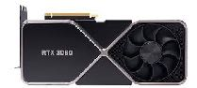
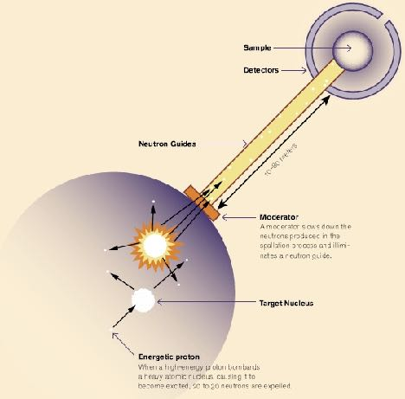
McStas and McXtrace overview
CPU’s
Portable code (Unix/Linux/Mac/Windoze)
Ran on everything from iPhone to 1000+ node cluster!
'Component' files (~200) inserted from library
Sources
Optics
Samples
Monitors
If needed, write your own comps
DSL + ISO-C code gen.
+ NVIDIA GPU’s

Slide 4
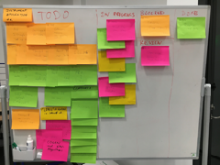
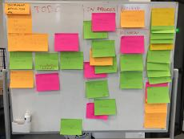
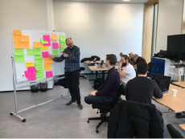






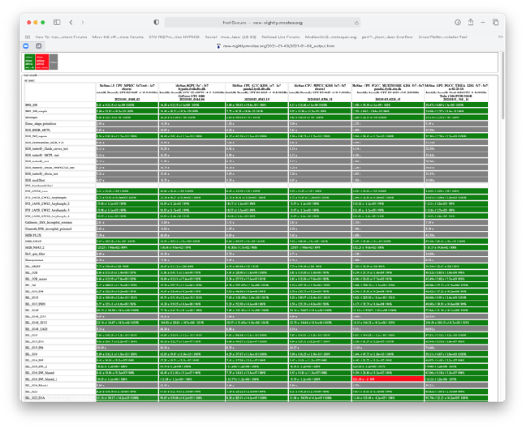
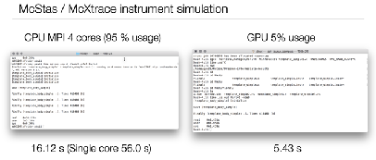
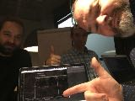
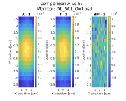


Main events on timeline of road toward GPU
December 15th 2020 McStas 3.0 release! November 24th 2021 McStas 3.1 release! February 8th 2022 McXtrace 3.0 release!
Fall 2018 onwards: J. Garde further cogen modernisation and restructuring
October 2019 onwards: J. Garde & P. Willendrup: New RNG, test system, multiple functional instruments.
January 2020: One-week local hackathon @ DTU
with McCode & RAMP teams
2017: E. Farhi initial cogen modernisation
November 2020 Virtual Hackathon, setting release scope
March 2018: Participation at Dresden Hackathon. 1st “null” instrument prototype runs.
October 2019: Participation at Espoo Hackathon. First meaningful data extracted. Work on cogen and realising we need another RNG.
November- December 2019: First good look at benchmarks and overview of what needs doing for first release with limited GPU support.
2020 1st Corona lockdown P. Willendrup & E. Knudsen continue work on comp and cogen
February 2020: First release McStas 3.0beta with GPU support was released to the public
mentor: Vishal Metha hackathon org.: Guido Juckeland
mentor: Christian Hundt hackathon org.: Sebastian Von Alfthan
Peter Willendrup, DTU Physics and ESS DMSC

Slide 5
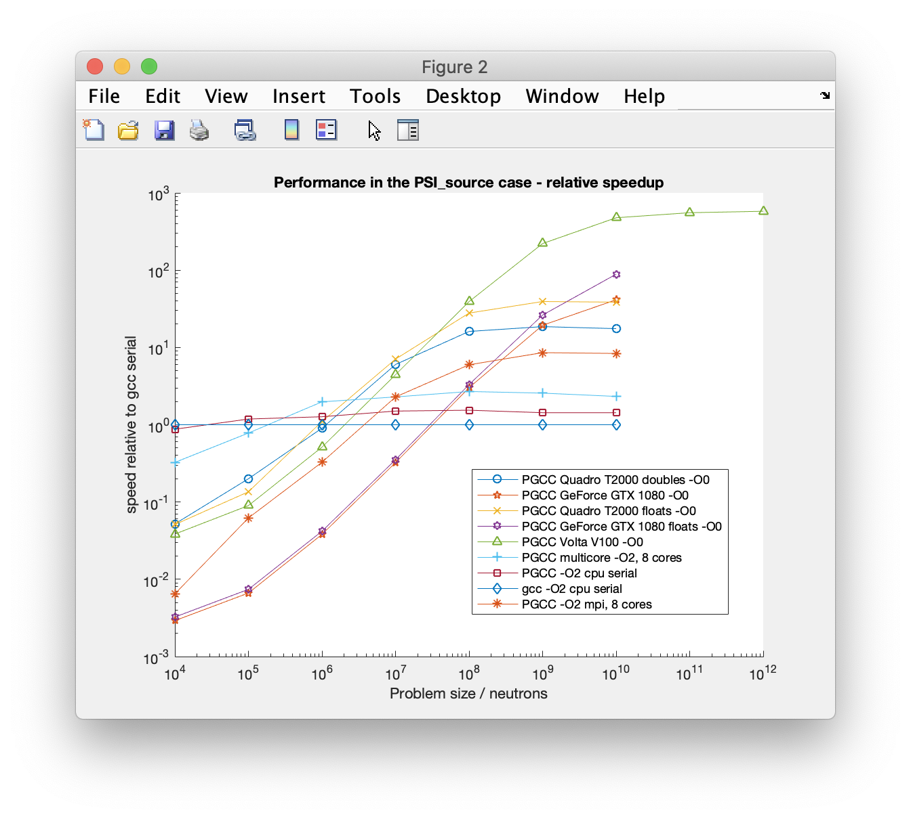
McStas heading for the GPU… November 2019 - first good look at performance.
Idealised instrument with source and monitor only - i.e. without any use of the ABSORB macro. (Likely a good indication of maximal speedup achievable.)
Speedup
Looks like a factor of ~600
~600
V100 execution speedups renormalised to wall- clock of single-core gcc standard simulation,
V100 run is 600 times faster than a single- core CPU run
Peter Willendrup, DTU Physics and ESS DMSC

Slide 6
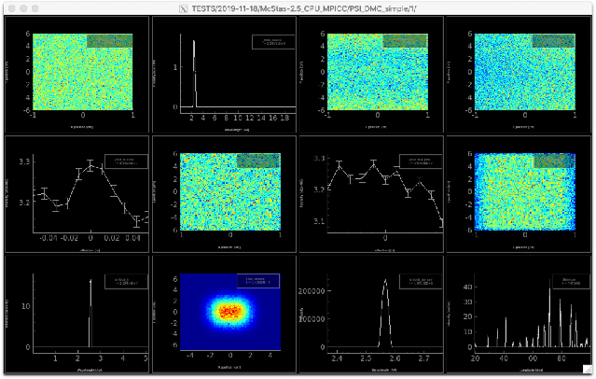

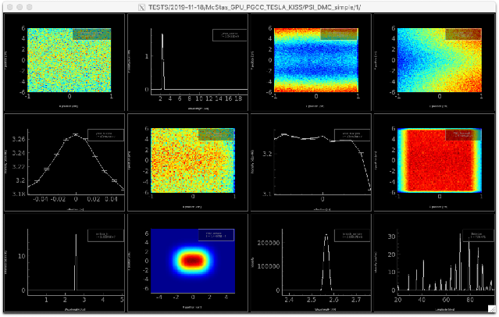
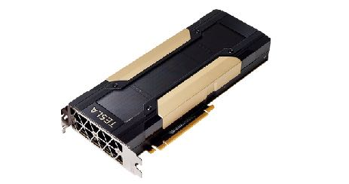
McStas heading for the GPU… first benchmarking numbers from November 2019
10-core MPI run, 1e9 in 200 secs
(1-core run, 1e9 would be 2000 secs)
9 instruments fully ported, also realistic ones like PSI_DMC (Aug 2020: 99 instrs)
vs.
~ i.e. 2 orders of magnitude wrt. a single, modern CPU core
Tesla V100 run, 1e9 in 22 secs
- If problem has the right size / complexity, GPU via OpenACC is great!
Peter Willendrup, DTU Physics and ESS DMSC

Slide 7
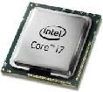
McStas 2.x -> McStas 3.0 main differences
Rewritten / streamlined simplified code-generator with
Much less generated code
improved compile time and compiler optimizations, esp. for large instrs
Much less invasive use of #define
Component sections -> functions rather than #define / #undef
Much less global variables, instrument, component and particle reworked to be structures
Use of #pragma acc … in lots of places (put in place by cogen where possible)
New random number generator implemented
We couldn’t easily port our legacy Mersenne Twister
Experimenting with curand showed huge overhead for our relative small number of random numbers (we have hundreds or thousands of randnom numbers, not billions)
Complete change to dynamic monitor-arrays
Advantage of 3.0 also on CPU

Slide 8
Anatomy of a McStas GPU run (*)
Init, geometry, files etc. read on CPU
MPI if needed
Memory-structures
Built on CPU
Marked for transfer to GPU (#pragma acc declare create etc.)
Initialised and synced across
Trace-loop is a #pragma acc parallel loop
Calculation performed entirely on GPU
Component structs (incl. e.g. monitor-arrays) synced across
Finally and Save runs on CPU
MPI merge if needed
No printfs etc. available on GPU, automatically suppressed by #defines
(* Alternative layout via FUNNEL mode, see next 2 slides)

Slide 9
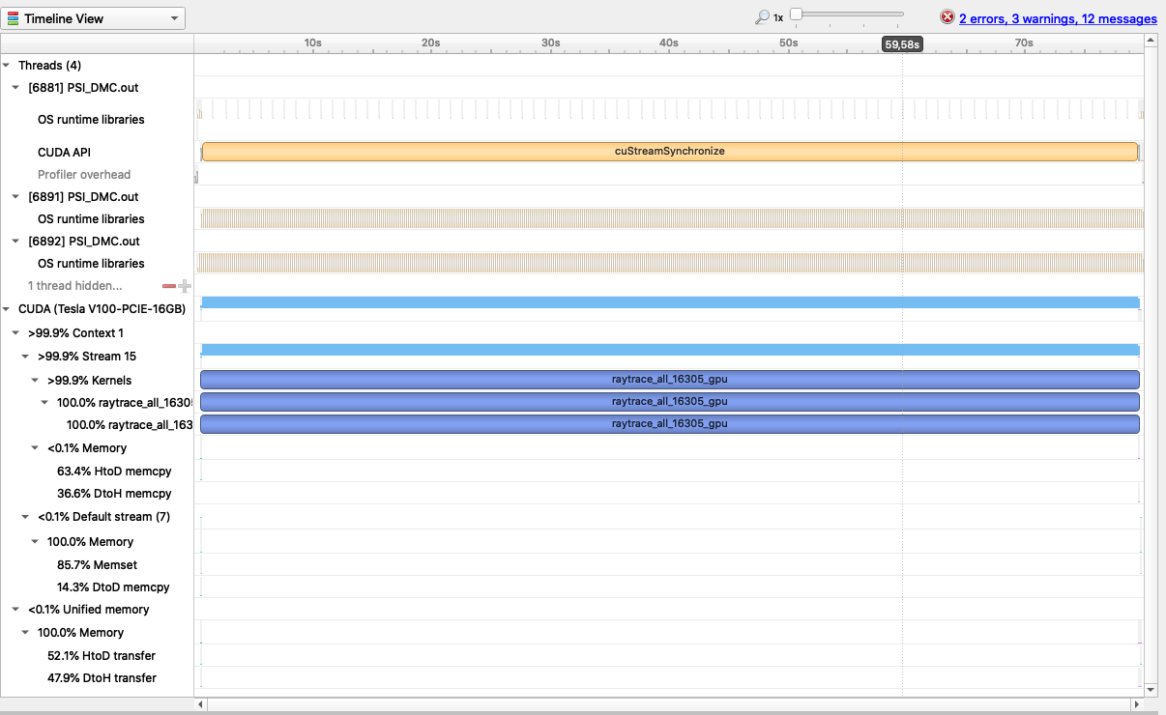
Profiling an example run…
Build and initialise instr/comp structures on host
Push problem to device
One big generated kernel calculates independent particle rays
Push back to host and save. Big problems, do multiple runs of the kernel for every ~2e9 rays (default is MAXINT limit, controllable via -DGPU_INNERLOOP).

Slide 10
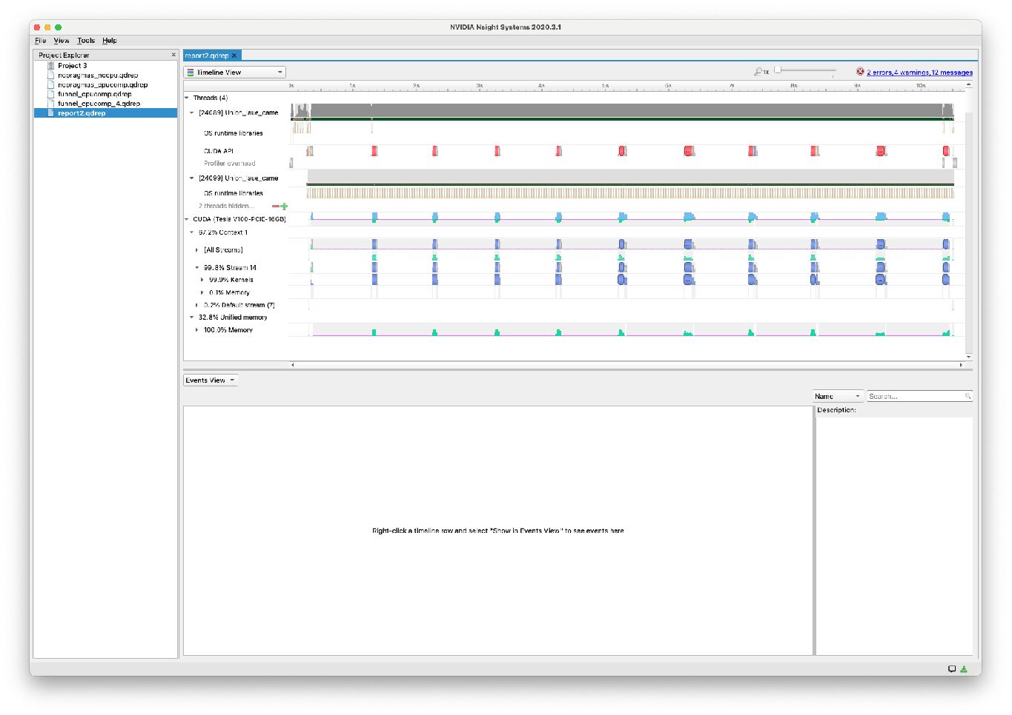
FUNNEL mode
Activated explicitly using -DFUNNEL or implicitly using CPUCOMPONENT in instrument or NOACC in comp header
Has N kernels / calculation zones instead of one
Separation at SPLIT
Separation if CPUCOMPONENT in instrument file ( CPUCOMPONENT A=Comp(vars=pars…) )
Separation if a component has NOACC in the header (See e.g. Multilayer_sample, Union_master )
Each of these “calculation zones” is finalised before the next one initiated.
Example: Union: Instrument up to Union_master can be GPU, then CPU, then GPU again
Can be as slow as single cpu…
Copying back and forth to/from GPU is costly…
Output from the code-generator: NOTE: CPU COMPONENT grammar activated:
1) "FUNNEL" raytrace algorithm enabled.
2) Any SPLIT's are dynamically allocated based on available buffer size.

Slide 11
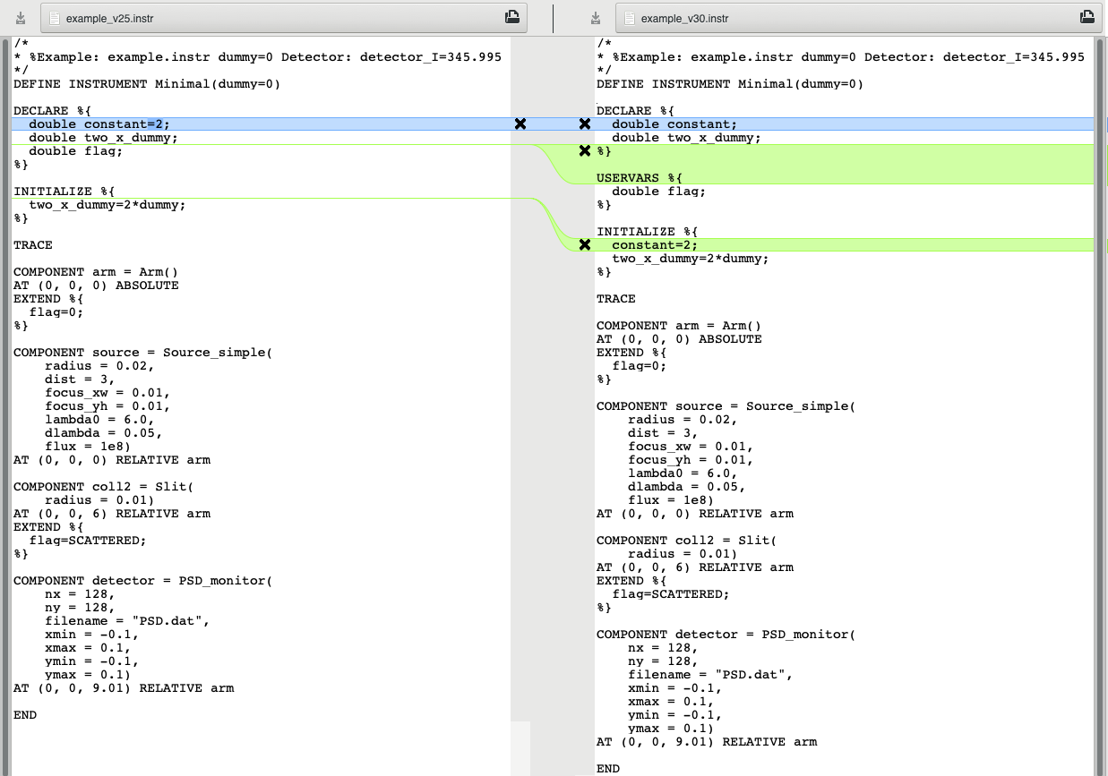
Illustration, simple instr with
Instr vars and “flag”
Arm
Source
Slit
PSD

Slide 12

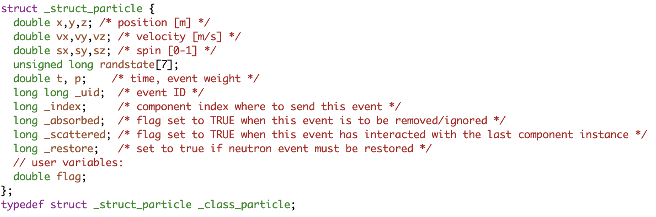
The particle and USERVARS in the instrument
(here shown for McStas)
v2.5: Global variables
Can be probed using e.g. Monitor_nD with user1=“flag” which uses the function
also works with e.g. “x”
v3.0: particle struct, including any USERVARS like flag.
double particle_getvar(_class_particle *p, char *name, int *suc)

Slide 13
The particle and USERVARS in the instrument
v2.5: Global variables
RNG state is a thread-variable contained on the _particle struct. Was earlier a global state in CPU settings
v3.0: particle struct, including any USERVARS like flag.
Side-effect: Every function in TRACE that uses random numbers must have _particle in the footprint
Also:
Particle state data are not global: Don’t use RESTORE_NEUTRON or RESTORE_XRAY in TRACE to do a local restore, the macro only raises a flag

Slide 14
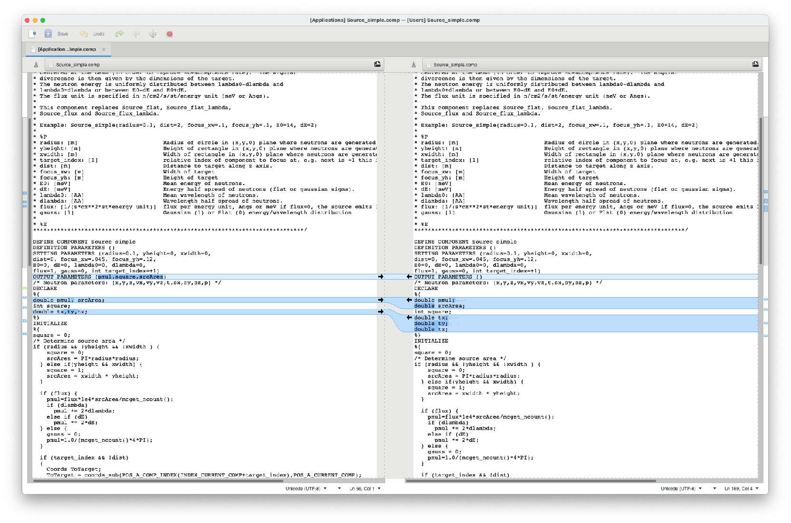
Source_simple minor changes

Slide 15
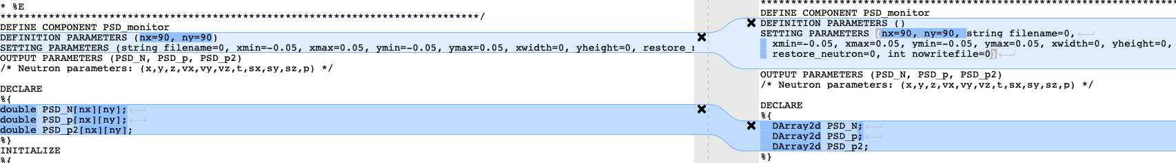
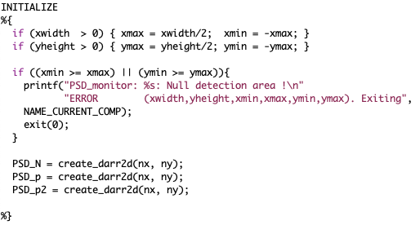
PSD has several changes
No more DEFINITION PARAMETERS
Use of new DArray2d for dynamic allocation

Slide 16
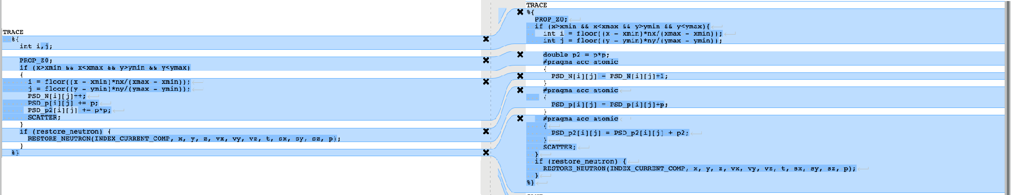
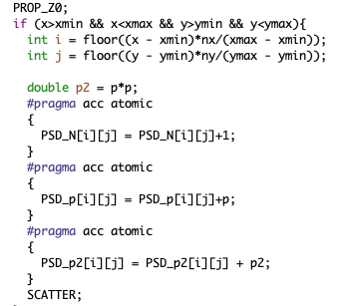
PSD lots of changes
Enabling atomic writes on the detector arrays

Slide 17
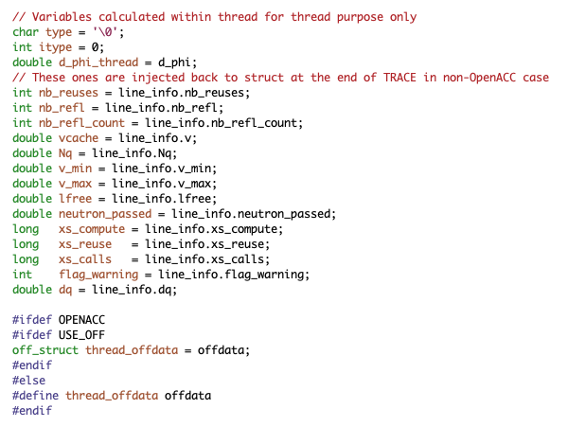
Samples required a good deal of (detective) work…
Key issue: (mis-) Use of / component DECLARE variables in TRACE for storing particle-dependent information, e.g. reflection list in PowderN etc. must be avoided.
Solutions:
1) Make local thread-variables, e.g.
2) Where meaningful, one could make atomic sections ala the monitors
Side-effect of thread-local vars:
Next neutron(s) in a SPLIT are no longer aware of e.g. available powder lines.
Potential, future solution: Mechanism to inject comp-specific code in the _particle

Slide 18
New monitor-tools for debugging use
Event_monitor_simple(nevents=1e6) - basic non-Monitor_nD event monitor. Writes a “log” file, independent from detector_out macros
Flex_monitor_1D , Flex_monitor_2D, Flex_monitor_3D, simple 1/2/3D “uservar” monitors tapping into the instrument USERVARS ala Monitor_nD
Useful for debugging even component internals: On mccode-3, if same ncount, same seed, same level of MPI parallelisation, the output should be identical on CPU and GPU

Slide 19
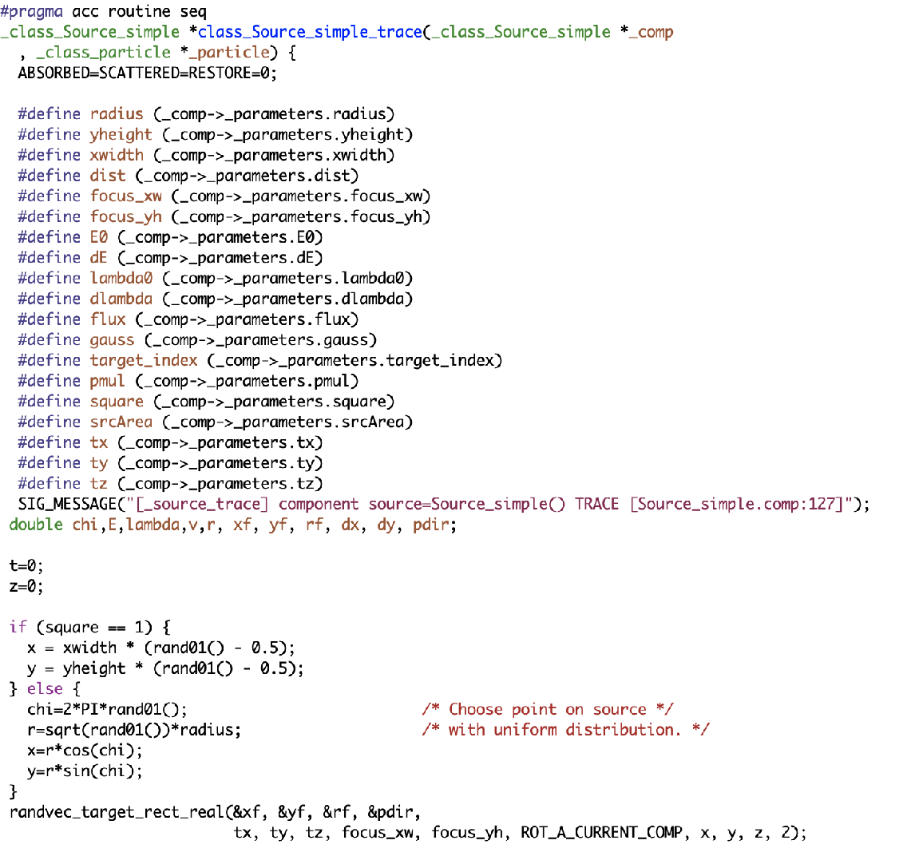
“Scatter-gather” approach not far from what we do in MPI settings, i.e. : GPU case: N particles are calculated in parallel in N GPU threads. (Leave to OpenACC/device how many actually are running at one time)
CPU case: N particles are calculated in M serial chunks over M processors.
Each component will correspond to a set of function. Trace is a GPU’ified function…
particle-loop and logic around, also running on GPU.
Init and finalisation codes run purely CPU.
Contains component trace
section
…. etc

Slide 20
Compiler settings used for GPU:
( McStas 3.0 mcrun is preconfigured on Linux - excluding -Minfo=accel, simply use mcrun --openacc when compiling, can also combine with e.g. --mpi=N )
nvc -ta=tesla,managed -Minfo=accel -DOPENACC
Main “enable GPU”/OpenACC switch
Give accel debug information
Use CUDA shared memory for host-device-host allocation. Needed for our 2D-arrays at present, may include penalty, we could get rid.
Generate Tesla code. “compute capability” e.g. tesla:cc70 may be specified to indicate specific card.

Slide 21
Compiler settings used for GPU:
nvc -ta=tesla,managed -Minfo=accel -DOPENACC
Defaults for “GPU neutron loops”: 1) non-funnelled GPU_INNERLOOP=2147483647 2) funnelled GPU_FUNNEL_INNERLOOP=1024*1024
For CPU/threading, use below settings, with -DMULTICORE e.g. printfs are not nullified in TRACE
Main “enable GPU”/OpenACC switch
Give accel debug information
nvc -ta=multicore -Minfo=accel -DOPENACC ( -DMULTICORE )
Use CUDA shared memory for host-device-host allocation. Needed for our 2D-arrays at present, may include penalty, we could get rid.
Generate Tesla code. “compute capability” e.g. tesla:cc70 may be specified to indicate specific card.

Slide 22

What doesn’t work
Function pointers are not available on GPU
Solutions:
Code around if possible (integration routine pr. specific function to be integrated…)
Mark the component NOACC
Variadic functions are not available on GPU
Anonymous structs as comp pars are not available on GPU
Unfold into comp struct
User-defined fieldfunctions for polarisation had to be abandoned
No solution yet, may become handled via grammar
External libs generally can not be used in TRACE (“#pragma….” hard to add on 3rd party codes)
Handle in INIT / FINALLY (MCPL)
NOACC (GSL etc.)
Union master is for now NOACC, will eventually become supported on GPU

Slide 23

Porting an instrument to 3.0 and GPU
Should give the SAME on CPU and GPU!
Instrument-level variables that are to become particle-dependent “flags”, e.g. for use in EXTEND WHEN must be put in the new section USERVARS %{ double flag; %}
Use of instrument input pars in extend and WHEN must use INSTRUMENT_GETPAR(varname)
Non-flag instrument vars to be used during TRACE / EXTEND / WHEN must be injected via #pragma acc declare create(var) and #pragma acc update device(var)
Declare-functions to be used in trace (e.g. in an EXTEND) must have #pragma acc routine

Slide 24
Common error-messages:
At compile-time, nvc is quite informative if using -Minfo:accel
At runtime, this indicates a GPU segfault
Often a symptom of “illegal access”, colliding memory, something isn’t thread-safe…
PGC-S-0155-Invalid atomic expression PGC-S-0000-Internal compiler error. Error: Detected unexpected atomic store opcode. PGC-S-0155-External variables used in acc routine need to be in #pragma acc create() - flag …
Failing in Thread:1
call to cuMemcpyDtoHAsync returned error 700: Illegal address during kernel execution

Slide 25
Porting a comp to GPU
Should give the SAME on CPU and GPU!
All pars must be setting parameters. New types: string a=“none” and vector b ( either ={1,2,3,4} static init or via pointer.)
All function-declarations must be moved to SHARE
DECLARE must only contain variable declarations. All initialization resides in INITIALIZE
If the comp uses external libs either
Avoid use in component TRACE (e.g. MCPL_input and output, handled in INIT/FINALLY)
Use NOACC keyword (e.g. Multilayer_sample use of GSL) - implies FUNNEL mode
Add #pragma acc routine to functions to execute in TRACE
Functions that call rand01() and friends must include _class_particle *_particle in footprint. (rand01() etc. are macros that carry thread-seed on _particle)s
Generally, don’t store ANY particle-derived vars on comp struct, make local TRACE vars instead.
Exception: Monitors, handle arrays in #pragma acc atomic clauses
Don’t use RESTORE_XRAY/NEUTRON in TRACE to do a local restore, the macro only raises a flag

Slide 26
Highlights of comps that work differently
Monitor_nD uservars are strings user1=“flag”, they use _particle_getvar to access instrument USERVARS
MCPL_input and MCPL_output do most of their work in INIT/FINALLY - buffers transferred for TRACE use
PowderN + Single_crystal + Isotropic_sqw don’t check for “same particle as before” - in SPLIT cases, no particle state info is kept (we could potentially use _particle and “USERVARS” injected from the comps…)

Slide 27
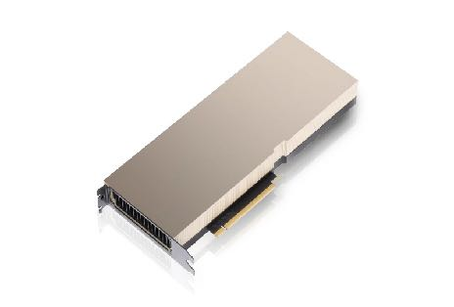
Conclusions
It really does work nicely!
Code changes much less invasive than envisioned!
It often gives a speedup of 1-2 orders of magnitude over 1 cpu
Most things work (we have workarounds or solutions in the pipe for the rest)
Documentation comes in the form of the released code + this set of slides…
McXtrace 3.0 and McStas 3.1 fully support GPU but not fully “optimised” performance-wise, we will try to go to another Hackathon
Union needs a dedicated Hackathon
Compilation with GCC 10 offloading support achieved May 2021 - but produces 0 on detectors… - hope for better GCC support and non-NVIDIA cards in 1-2 years

Slide 28
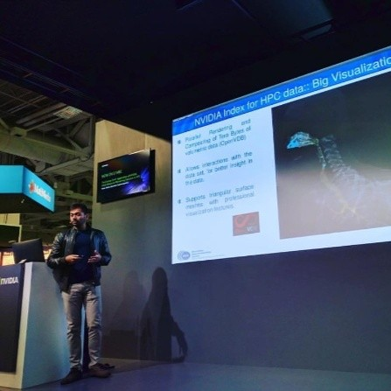
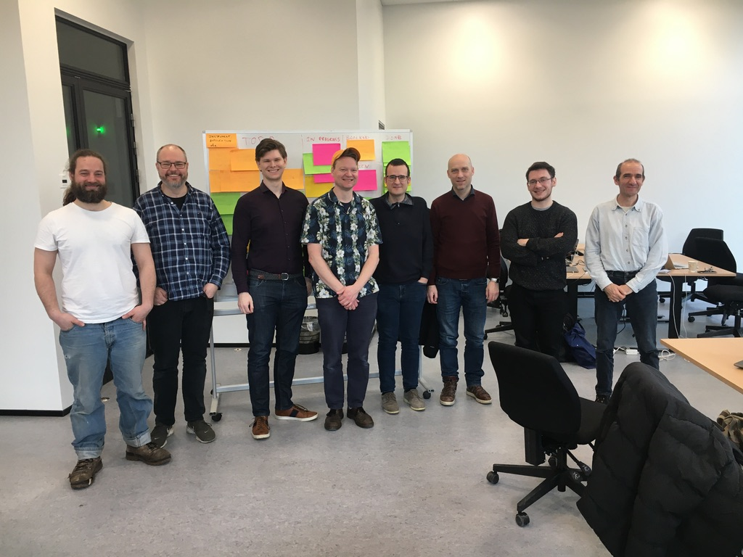




The team, Nvidia mentors and Hackathon hosts :-)
Vishal Metha
Gino - (RAMP)
Guido Juckeland
Torben
Peter
Mads
Tobias
Erik
Jakob
Emmanuel
Christian Hundt
Alexey Romanenko
Sebastian von Alfthan
Peter Willendrup, DTU Physics and ESS DMSC

